Slide 1
Lecture # 7
Binary Heaps
Heap Sort

Slide 2
Heaps
A heap can be seen as a complete binary tree:
  What makes a binary tree complete?
  Is the example above complete?
16
14
10
8
7
9
3
2
4
1

Slide 3
Heaps
A heap can be seen as a complete binary tree:
  Some books calls them “nearly complete” binary trees; can think of unfilled slots as null pointers
16
14
10
8
7
9
3
2
4
1
1
1
1
1
1

Slide 4
Heaps
In practice, heaps are usually implemented as arrays:
16
14
10
A =
16
14
10
8
7
9
3
2
4
1
=
8
7
9
3
2
4
1

Slide 5
Heaps
To represent a complete binary tree as an array:
  The root node is A[1]
  Node i is A[i]
  The parent of node i is A[i/2] (note: integer divide)
  The left child of node i is A[2i]
  The right child of node i is A[2i + 1]
1
16
1
2
3
4
10
14
2
3
10
A =
16
14
10
8
7
9
3
2
4
1
=
8
4
7
5
6
9
7
3
2
4
1
8
9
10

Slide 6
Referencing Heap Elements
So…
  Parent(i) { return ⎣i/2⎦; }
  Left(i) { return 2*i; }
  right(i) { return 2*i + 1; }

Slide 7
The max-Heap Property
max-heap property says:
A[Parent(i)] ≥ A[i] for all nodes i > 1
  In other words, the value of a node is at most the value of its parent
  Where is the largest element in a heap stored?
Definitions:
  The height of a node in the tree = the number of edges on the longest downward path to a leaf
  The height of a tree = the height of its root

Slide 8
The min-Heap Property
min-heap property says:
A[Parent(i)] ≤ A[i] for all nodes i > 1
  Where is the smallest element in a heap stored?

Slide 9
Heap Height
What is the height of an n-element heap? Why?
Basic heap operations take at most time proportional to the height of the heap

Slide 10
Heap Operations: Max-Heapify(A,i)
Max-Heapify(): maintain the heap property
  Its input is an Array A and an index i of array
  Left and right sub trees of node i are assumed to be max-heaps.
  Problem: The sub tree rooted at i may violate the heap property (How?)
  Action: let the value of the parent node “float down” so sub tree at i satisfies the heap property

Slide 11
Max-Heapify( ) Example
16
4
10
14
7
9
3
2
8
1
A =
16
4
10
14
7
9
3
2
8
1

Slide 12
Heapify() Example
16
4
10
14
7
9
3
2
8
1
A =
16
4
10
14
7
9
3
2
8
1

Slide 13
Heapify() Example
16
4
10
14
7
9
3
2
8
1
A =
16
4
10
14
7
9
3
2
8
1

Slide 14
Heapify() Example
16
14
10
4
7
9
3
2
8
1
A =
16
14
10
4
7
9
3
2
8
1

Slide 15
Heapify() Example
16
14
10
4
7
9
3
2
8
1
A =
16
14
10
4
7
9
3
2
8
1

Slide 16
Heapify() Example
16
14
10
4
7
9
3
2
8
1
A =
16
14
10
4
7
9
3
2
8
1

Slide 17
Heapify() Example
16
14
10
8
7
9
3
2
4
1
A =
16
14
10
8
7
9
3
2
4
1

Slide 18
Heapify() Example
16
14
10
8
7
9
3
2
4
1
A =
16
14
10
8
7
9
3
2
4
1

Slide 19
Heapify() Example
16
14
10
8
7
9
3
2
4
1
A =
16
14
10
8
7
9
3
2
4
1

Slide 20

Analyzing Heapify( )
The number of nodes in a complete binary tree of height h is
So h in terms of n is:
h = ( log(n + 1) ) - 1 ≈ log n Є Ө(log n)
Running time of Max-Heapify( ) on a node of height h will be O(lg n) or O(h).

Slide 21
Heap Operations: BuildHeap()
We can build a heap in a bottom-up manner by running Heapify() on successive subarrays
  Fact: for array of length n, all elements in range
  A[ ⎣n/2⎦ + 1 .. n ] are heaps (Why?)
  Ans: Because sub array A[ ⎣n/2⎦ + 1 .. n ] are all leaves.
  So:
    Walk backwards through the array from n/2 to 1, calling Heapify() on each node.
    Order of processing guarantees that the children of node i are heaps when i is processed

Slide 22
BuildHeap() Example
Work through example
A = {4, 1, 3, 2, 16, 9, 10, 14, 8, 7}
4
1
3
2
16
9
10
14
8
7

Slide 23
BuildHeap( )
For array of length n, all elements in range
A[ ⎣n/2⎦ + 1 .. n ] are leaves of the tree.
The procedure BuildHeap( ) goes through the remaining each and every node of the tree and apply Heapify( ) on every node so that the whole tree is in the form of heap, having all heap properties.

Slide 24
Analyzing BuildHeap( )
Each call to Max-Heapify() costs O(lg n) or O(h) time, and
There would be total of O(n) such calls
( specifically, ⎣n/2⎦ ) for complete set of nodes in a heap.
Thus the running time is O(n.lg n). This upper bound is correct but not asymptotically tight.

Slide 25
Analyzing BuildHeap(): Tight bound
The time required by max-heapify() when called on single node of height h is O(h).
Fact: an n-element heap has height ⎣lg n⎦ and at most ⎡n/2^{h+1}⎤ nodes of any height h.
( leaves are at height 0 )
We have the formula:
∑ k.x^{k} = x / (1-x)² for |x| < 1
Put x = ½ < 1
∑ k/2^{k} = 2
∞
k=0
∞
k=0

Slide 26
h=0
So we can express the total cost of BuildHeap() as follows.
∑ ⎡n /2^{h+1}⎤ . O(h) = O ( n . ∑ ⎡ h /2^{h}⎤ )
⎣lg n⎦
⎣lg n⎦
h=0
As ∑ h/2^{h} = 2
∞
h=0
Thus running time of BuildHeap() can be O(n).

Slide 27
Heapsort
Given BuildHeap(), an in-place sorting algorithm is easily constructed:
  Maximum element is at A[1]
  Discard by swapping with element at A[n]
    Decrement heap_size[A]
    A[n] now contains correct value
  Restore heap property at A[1] by calling Heapify()
  Repeat, always swapping A[1] for A[heap_size(A)]

Slide 28
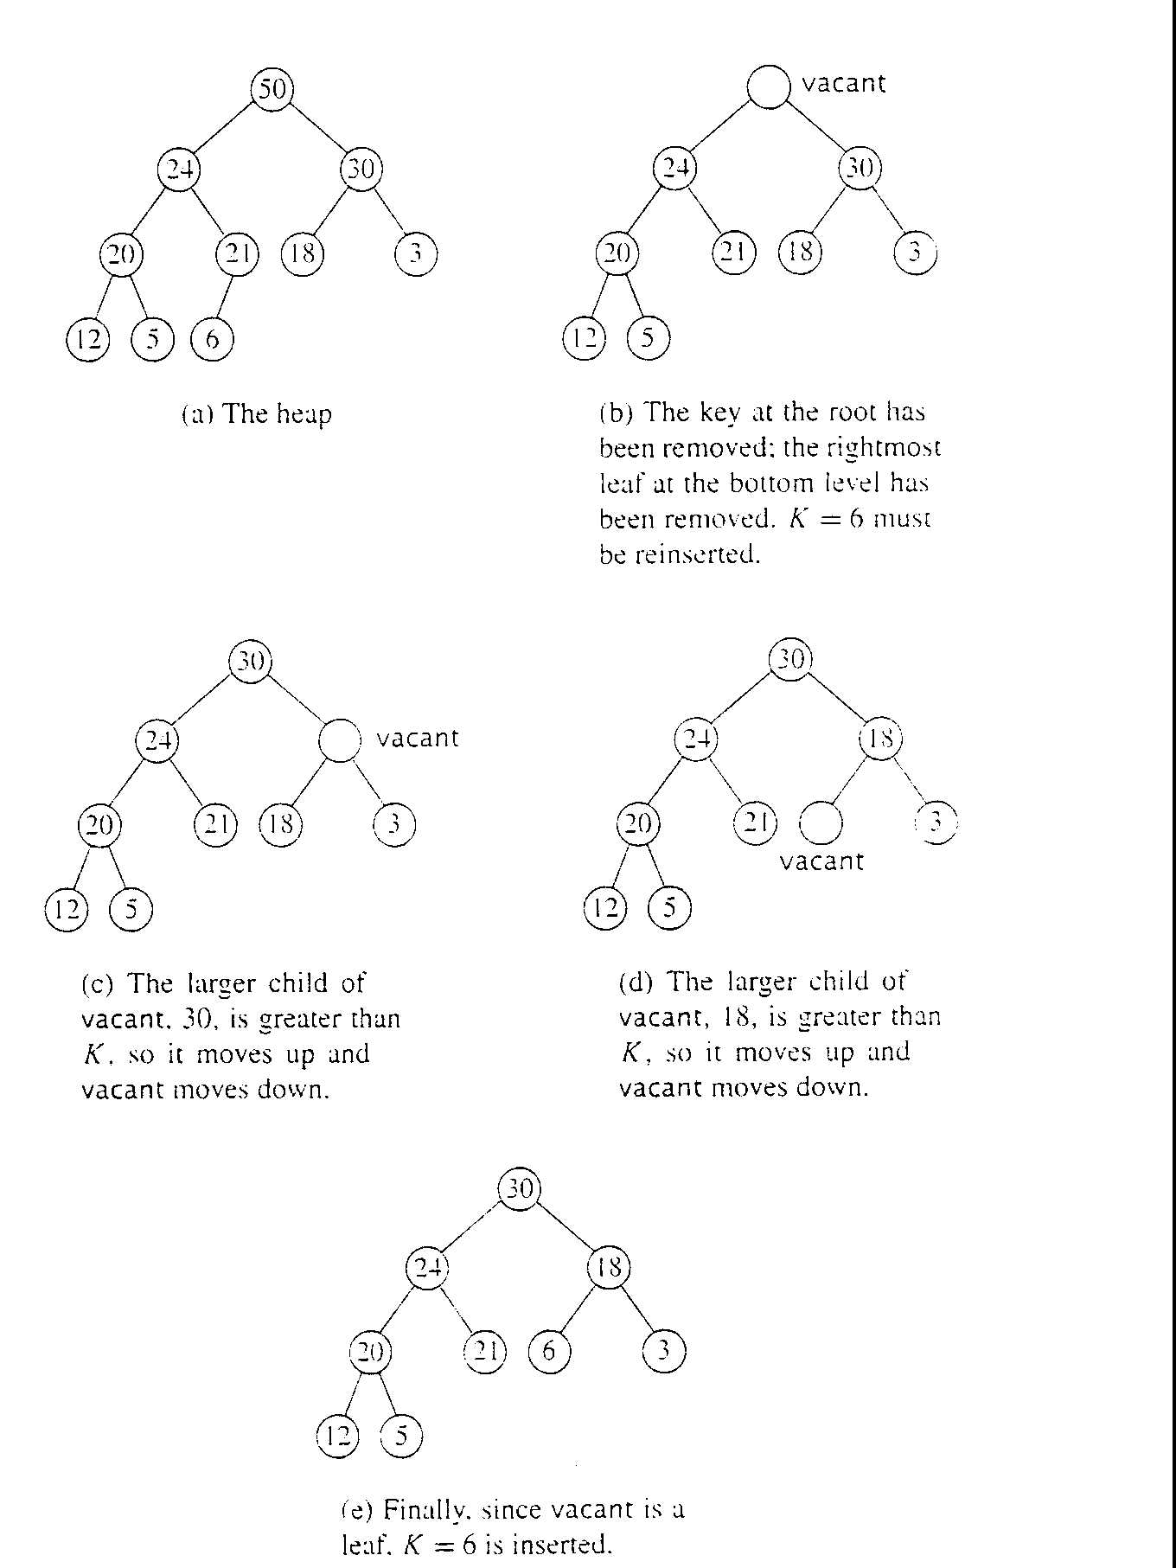
Heapsort in action

Slide 29
View book (Cormen) page number 137 figure 6.4 for better understanding of heap sort mechanism for following Tree.
16
14
10
8
7
9
3
2
4
1

Slide 30
Analyzing Heapsort
The call to BuildHeap() takes O(n) time
Each of the n - 1 calls to Heapify() takes
O(lg n) time
Thus the total time taken by HeapSort()
= O(n) + (n - 1) O(lg n)
= O(n) + O(n lg n)
= O(n lg n)

